Slide 1
Secure Access Project
By
Shreevatsa PU
Sai Spandan
Udbhav Kumar

Slide 2
OTPs and Their Challenges
Definition: A One-Time Password (OTP) is a temporary passcode that is valid for only one login session or transaction.
Delivery Method: OTPs are commonly sent via SMS to the user's registered mobile number or can be generated by an authentication app.
Format: Typically consists of 6 to 8 digits.
Validity: Valid for a very short time, usually 30 seconds to a few minutes, enhancing security.
Current Challenges
Vulnerabilities: Social Engineering; Attackers may trick users into sharing their OTPs, for example, through phishing scams or fraudulent phone calls.
Fraud Risks: Once an attacker has the OTP, they can easily access the user's account, leading to unauthorized transactions or data breaches.
Inherent Limitations: While OTPs reduce the risk of password reuse, they are still susceptible to interception during delivery.

Slide 3
Proposed Solution
Secure OTP Delivery:
Churned OTPs: Instead of sending the original OTP, the system delivers a rearranged or remapped version that has no intrinsic value to an attacker.
Derivation Mechanism: The legitimate user can securely obtain the original OTP using a secret key and authentication process, ensuring only authorized access.
Enhanced Security: By making the OTP format meaningless to attackers, the likelihood of successful fraud attempts decreases.

Slide 4
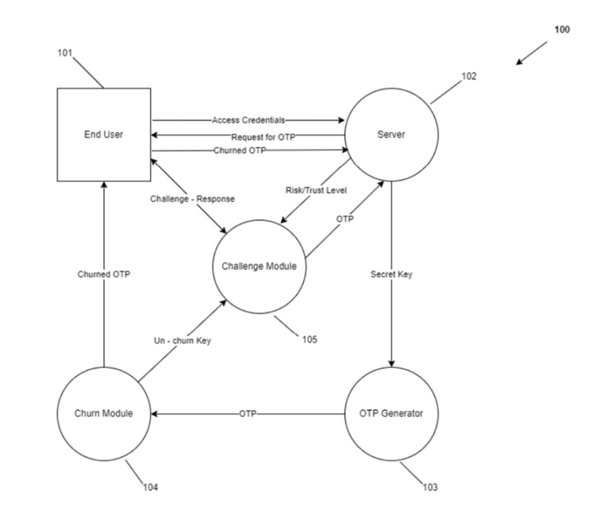
System Architecture

Slide 5
System Architecture (contd.)
End User: Requests an OTP when accessing a service.
Server: Validates the request and generates the churned OTP.
Churn Module: Creates the churned OTP using a secure algorithm.
Challenge Module: Confirms user identity and ensures OTP is delivered securely.
Communication Flow: User and server communicate through a secure channel.

Slide 6
Implementation Ideas
Key Components:
Churn Module:
Develop an algorithm to transform the OTP into a non-sequential, scrambled format.
Ensure the method for retrieving the original OTP is secure and involves authentication.
Challenge-Response Mechanism:
Design a verification process that validates the user's identity before sending the OTP.
Implement a feedback mechanism to confirm successful OTP receipt.
Integration:
Create APIs or interfaces to allow existing systems to adopt the new OTP delivery method with minimal modifications.

Slide 7
Future Updates
Potential Enhancements:
Machine Learning Algorithms:
Use ML models to analyze user behavior and detect anomalies, enhancing the risk assessment for OTP requests.
Mobile App Development:
Create a dedicated mobile application for managing OTPs, allowing users to receive and store them securely.
Biometric Integration:
Explore options for combining OTPs with biometric verification (fingerprint, facial recognition) to add an additional layer of security.

Slide 8
Questions
Doesn’t this system completely remove the convenience factor of OTPs?
How to start the implementation part of this project?
How to implement the challenge module? Does it need to be personal for each user, e.g. Your pet's name, Your first school, etc.?
What’s the method for the churning of OTPs? Is it just rearrangement or completely using a mathematical formula/algorithm?
What if the user is switching to a new phone? Will the user go through the same set of steps or is there an exception?

Slide 9
Thank You

